Slide 1
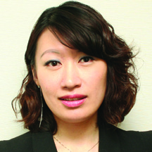
Market Hong Kong Leadership School 2014
美安香港領袖訓練會議2014
Emmy Yeung
Jason Lam
產品拓展經理
Product Manager
產品拓展主任
Product Officer

Slide 3
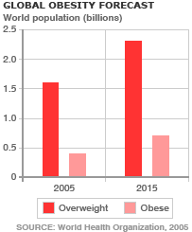
為甚麼你應考慮與顧客談論體重問題？ Why Should You Consider Talking About the Weight with your Customers?
自1980年以來全球的肥胖人口增加了近一倍
在2008年，超過14億20歲以上的成年人體重超標 當中超過2億男性及接近3億女性屬於癡肥
在2008年， 35％的20歲以上成年人超重，11％為癡肥
在2012年， 超過40萬名5歲以下的兒童超重或癡肥
肥胖是可以預防的
Worldwide obesity has nearly doubled since 1980
In 2008, more than 1.4 billion adults, 20 and older, were overweight. Of these over 200 million men and nearly 300 million women were obese
35% of adults aged 20 and over were overweight in 2008, and 11% were obese
More than 40 million children under the age of 5 were overweight or obese in 2012
Obesity is preventable
Source: http://www.who.int/mediacentre/factsheets/fs311/en/

Slide 4
為甚麼你應考慮與顧客談論體重問題？ Why Should You Consider Talking About the Weight with your Customers?
本地情況
Local Situation
於二零一二年四月年齡介乎18至64歲之間人士的選定健康風險
April 2012, Specific health risk for people aged between 18 -64 years old
超重及肥胖 (體重指標23.0或以上)
Overweight and Obesity (with BMI 23 or above)
男性47.2%
女性27.8%
合計36.6%
Male: 47.2%
Female: 27.8%
Total: 36.6%
體能活動量不足
(按世界衞生組織的建議)
Sedentary Lifestyle (According to WHO recommendation)
男性53.0%
女性66.6%
合計60.4%
Male: 53.0%
Female: 66.6%
Total: 60.4%
Source: http://www.dh.gov.hk/tc_chi/statistics/statistics_hs/files/Health_Statistics_pamphlet_TC.pdf

Slide 5
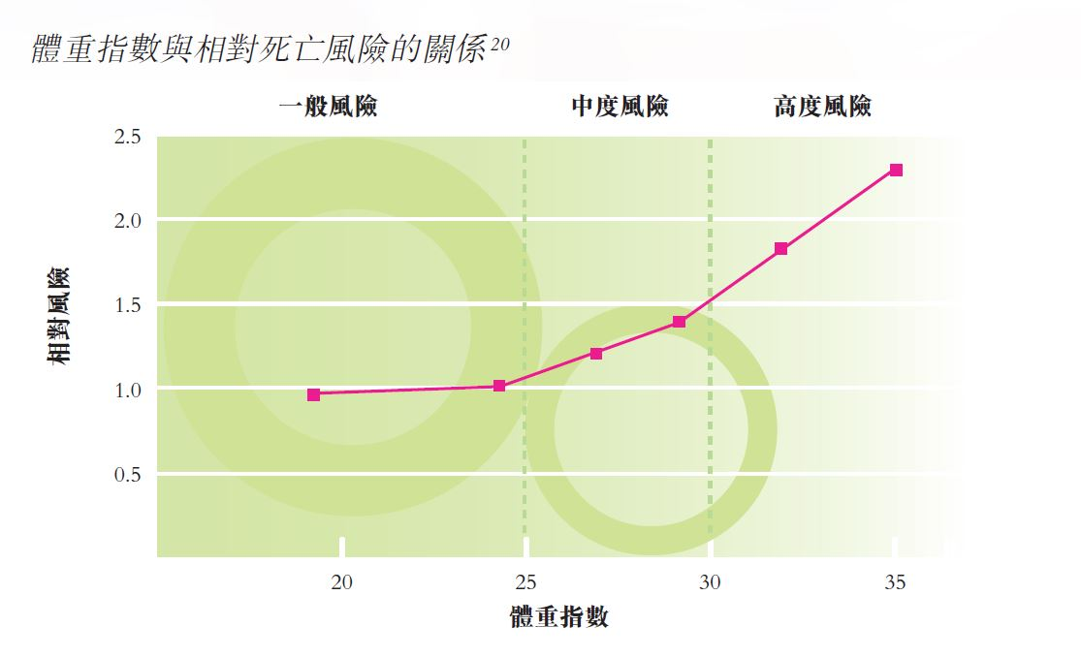
為甚麼你應考慮與顧客談論體重問題？ Why Should You Consider Talking About the Weight with your Customers?
與肥胖相關之健康問題的相對風險 Relative health risk with overweight & obesity
稍微增加 1 至 2 倍 Risk increased slightly from 1-2 times | 中度增加 2 至 3 倍 Risk increased moderately between 2-3 times | 大幅增加逾 3 倍 Risk increased substantially by over 3 times
某幾類癌症 （結腸癌及停經後婦女所患的乳癌) Some specific cancers (Colon and postmenopausal breast cancer) | 冠心病 Coronary disease | 糖尿病 Diabetes
生殖激素異常 Reproductive hormone abnormalities | 高血壓 Hypertension | 膽囊疾病 Gallbladder Disease
腰痛 Lower back Pain | 骨關節炎 Osteoarthritis | 血脂或膽固醇水平異常 Abnormal level of triglyceride or cholesterol
生育力受損 Impairment of Fertility | 痛風症 Gout | 睡眠窒息症 Sleep Apnea Syndrome
Source: http://www.info.gov.hk/healthzone/chp/grp-pmpdb-obesity_tc.pdf

Slide 6
很多人都試過減重 Everyone Is On Board For a While
然後…
顧客對「生活質素」 感到不滿
動力下降，感到難以遵從減重計劃
「節食人士」希望走「捷徑」，忽略以下各項的重要性：
運動
睡眠
壓力管理
And then…
Customers complain about “Quality of Life” factors
Lose momentum and find it difficult to stay compliant
“Dieters” want a “quick fix” and forget the importance of:
Exercise
Sleep
Stress Management
Notes:
Weight management market such as MTR ad.

Slide 7
纖形業務－800億美元市場 Weight Loss Market – USD80 BILLION Industry
纖形行業可分6個類型
食物、代餐及飲品
藥物
醫療
營養補充品
健身、器械及配件
纖形業務
Diet Industry falls into 6 different categories
Food, Substitutes & Beverages
Drug
Clinical
Supplements
Fitness, Devices, and Accessories
Commercial
Notes:
Day 1 Slide – Growth in past 5 Years

Slide 8
纖形業務－800億美元市場 Weight Loss Market – USD80 BILLION Industry
七成人喜歡自己進行纖形而不選擇每星期幾次到纖形中心、診所或醫院參加正規、有系統的纖形計劃。
這些人仍需要及希望得到協助
70% of people prefer to lose weight by themselves rather than joining a formal, structured program that requires several visits per week to a weight loss center, clinic or hospital.
These People Still NEED and WANT Support

Slide 9
TLS®健康生活纖營計劃
TLS® Weight Loss Solution
行為修正
Behavioral
Modification
健康飲食
低升糖指數飲食 Healthy Eating
Low GI Diet
身體構成
Body
Composition

Slide 10
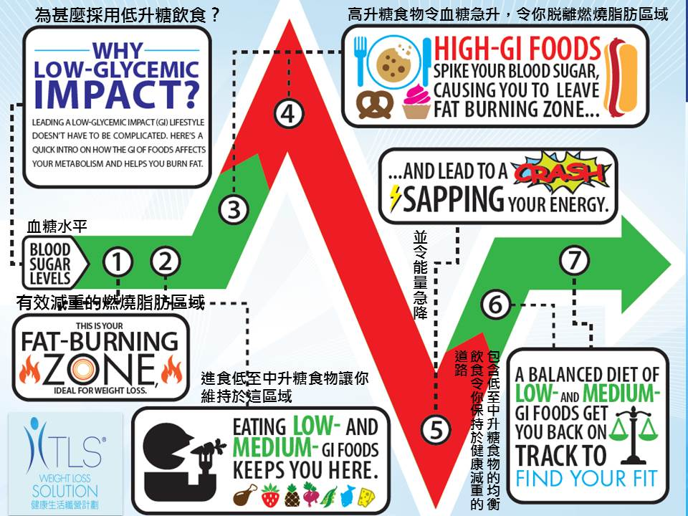
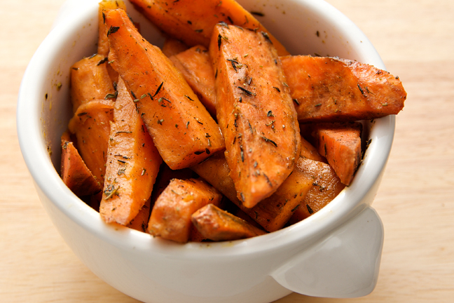
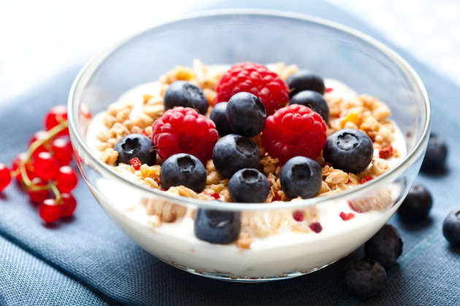
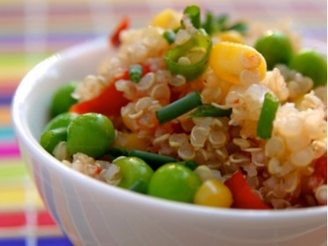
低升糖指數飲食
Low Glycemic Index Diet
低升糖飲食
有助減重及體重管理
維持瘦肌肉量
心血管健康
Low Glycemic Impact Eating
Superior for weight loss and weight management
Maintaining lean muscle mass
Cardiovascular health

Slide 11
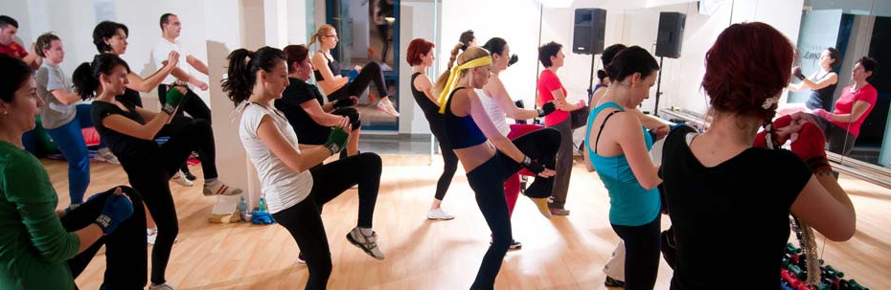
身體構成 Body Composition
身體構成
修復及提升新陳代謝
運動
Body Composition
Repair and increase metabolism
Exercise
脂肪比例 Fat Percentage
 | 女性 Female | 男性 Male
正常(30歲以下） Normal (Below 30 years old) | 17-24% | 14-20%
正常(30歲以上） Normal (30 years old or above) | 20-27% | 17-23%
肥胖 (Obesity) | 30%+ | 25%+

Slide 12
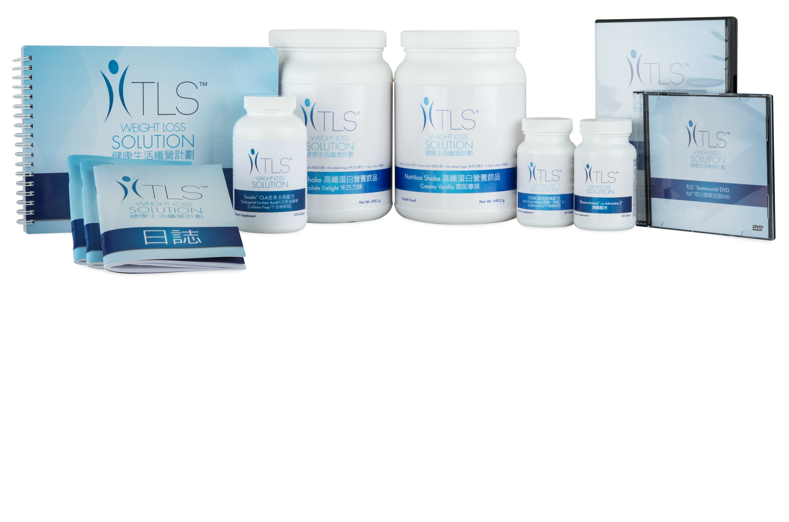
加速減重產品／補充品 Weight Loss Accelerators / Supplements
優質營養來源
支援健康新陳代謝
促進體重指數(BMI)下降
有助降低整體身體脂肪
Provides great source of nutrients
Supports healthy metabolism
Promotes reduction in body mass index (BMI)
Helps reduce overall body fat

Slide 13
2014 新產品
New PRODUCTS

Slide 14
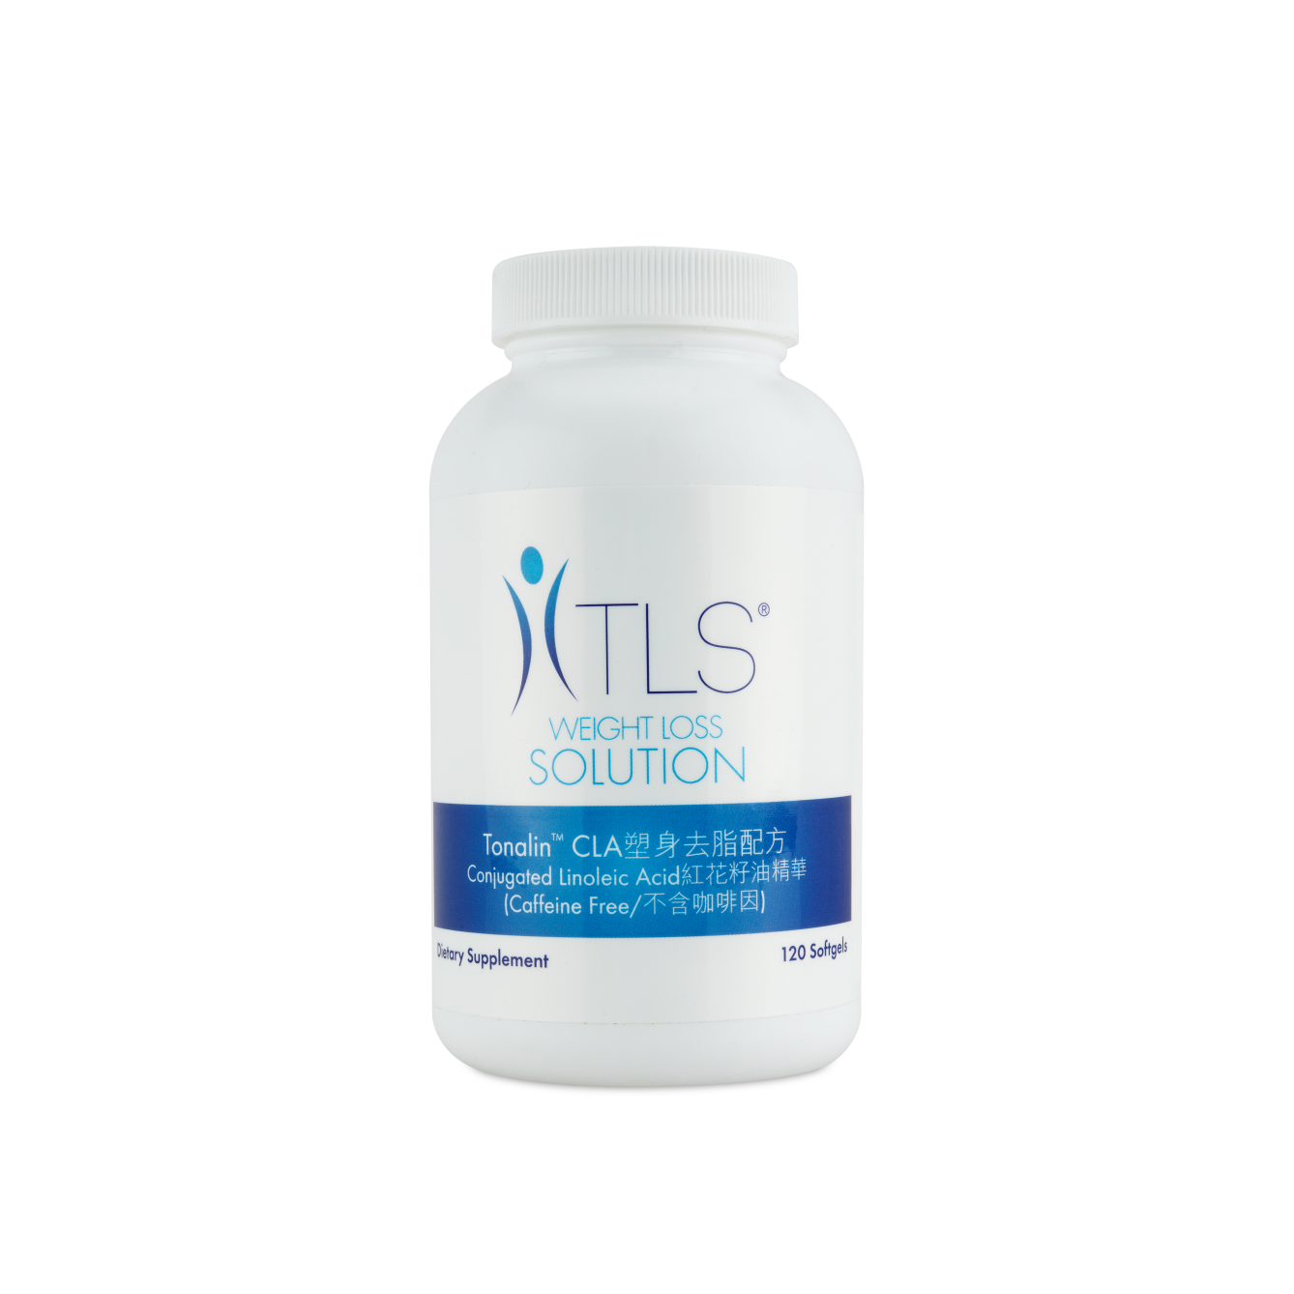
TLS® 塑身去脂配方－紅花籽油精華
Tonalin™ CLA (Conjugated Linoleic Acid)
隆重登場NEW

Slide 15
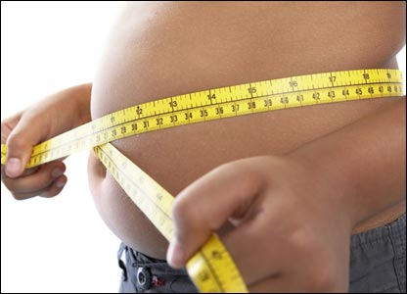
https://www.youtube.com/watch?v=WwbUpPnYw8k
中央肥胖 Central Obesity
中央肥胖(俗稱「大肚腩」)，即腹部積聚過量
研究指出腰圍可反映腹部脂肪積存的程度，從而評估個人的患病風險。
衛生署過往有調查顯示，男士過胖人數不斷上升，大腸癌的數字也持續增加。
在二型糖尿病患者中，有80%都屬於腰圍超標一族
Central Obesity (Belly fat) – Over accumulation of abdominal fat
Studies show that waistline can reflect the level of accumulation of abdominal fat which can be evaluated the risk of getting diseases.
Previous studies of Department of Health show that the number of overweight male is increasing constantly while the number of colorectal cancer is increasing as well
80% of Type 2 diabetes patients are with excessive level of waistline
亞洲成年人中央肥胖指標
性別Sex | 腰圍Waistline
男Male | ≧90cm
女Female | ≧80cm
Source: https://hk.news.yahoo.com/%E4%B8%AD%E5%A4%AE%E8%82%A5%E8%83%96%E8%87%B4%E7%99%BE%E7%97%85--%E5%B0%8F%E5%BF%83%E5%A4%A7%E8%82%9A%E8%85%A9.html

Slide 16
TLS® 塑身去脂配方－紅花籽油精華
Tonalin™ CLA (Conjugated Linoleic Acid)
主要好處： Primary Benefits:
或有助針對頑固腹部脂肪
配合運動使用有助降低整體身體脂肪
有助促進肌肉量
促進身體利用體脂肪作為能源
May help to target stubborn belly fat
Helps reduce overall body fat when used in combination with exercise
Assists in promoting lean muscle mass
Promotes the utilization of body fat as fuel

Slide 17
共軛亞油酸
CLA (Conjugated Linoleic Acid)
有助促進和維持肌肉，可締造修身
通過重新分配脂肪到肌肉組織進行脂肪燃燒，促進身體脂肪量減少
Assists in promoting and preserving lean muscle, which may slim the body.
Promotes body fat loss by redistributing fat to fat-burning muscle mass.

Slide 18
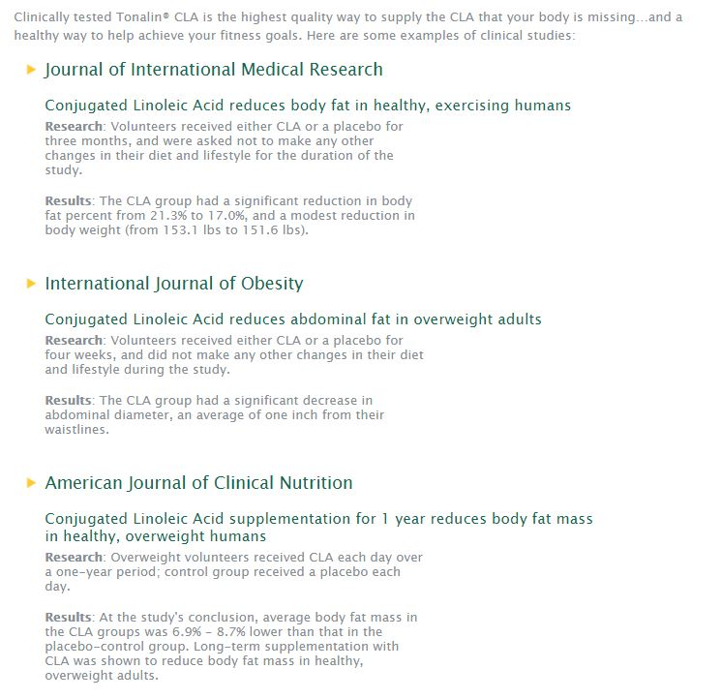
為何是 Tonalin™ CLA? Why Tonalin™ CLA?
由美國食品及藥物管理局認證為GRAS安全認證，代表承認是已經通過最高安全標準的食品原料
Recognized by the U.S. Food & Drug Administration as FDA GRAS, which means it has passed their highest safety standards for a food ingredient
大量臨床研究顯示其健康及高質素效果
Clinical studies showing the healthy and highest quality results
美國臨床營養學雜誌
健康但超重的人士補充共軛亞油酸1年可有效減少體脂
研究方法：志願的超重人士接受每天補充共軛亞油酸超過1年時間;對照組則每天服用安慰劑。
結果：研究結論，補充共軛亞油酸人士的體脂比安慰劑對照組的平均低6.9％ - 8.7％。長期補充共軛亞油酸被證實可以降低體內脂肪量的健康，體重超重的成年人。
American Journal of Clinical Nutrition
Conjugated Linoleic Acid supplementation for 1 year reduces body fat mass in healthy, overweight humans
Research: Overweight volunteers received CLA each day over a one-year period; control group received a placebo each day.
Results: At the study's conclusion, average body fat mass in the CLA groups was 6.9% - 8.7% lower than that in the placebo-control group. Long-term supplementation with CLA was shown to reduce body fat mass in healthy, overweight adults.

Slide 19
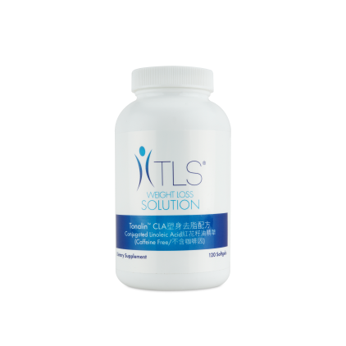
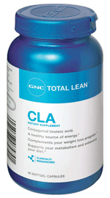
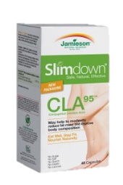
產品名稱 Product Name | 每天共軛亞油酸份量 CLA per Day | Tonalin™ CLA ? | 食用份量/ 零售價 Servings / Price | 每食用份量 零售價 Price per Serving
TLS®塑身去脂配方 －紅花籽油精華 TLS® Tonalin™ CLA (Conjugated Linoleic Acid) | 3500mg |  | 60 /HK$400 | HK$6.7
紐崔萊型體樂 Nutrilite SAFFLOWER AND CITRUS | 1800mg |  | 30 /HK$557 | HK$18.6
Catalo消脂纖 CLA Slim Natural | 3000mg |  | 45 /HK$350 | HK$7.8
GNC CLA 共軛亞麻油酸 | 2000mg |  | 90 /HK$649.9 | HK$7.2
Jamieson殲脂CLA (共軛亞麻油酸) Slimdown® CLA 95™ | 3800mg |  | 22.5 /HK$202 | HK$9.0

Slide 20
TLS® 塑身去脂配方－紅花籽油精華
Tonalin™ CLA (Conjugated Linoleic Acid)
Code: HK6428 UC:HK$290.00 | SR:HK$400.00 | BV: 20 60 份量Servings
隆重登場NEW

Slide 21
TLS®健康生活纖營計劃
TLS® Weight Loss Solution
增加活動及運動量：
跳舞、保齡球、走路、
單車、行樓梯
健康飲食：
低升糖指數飲食、
蛋白質、蔬菜、
水果、纖維 、
健康脂肪、水
Increase Activity Level:
Dancing, Bowling, Walking,
Cycling and Walking up
Stairs
20%
Healthy Eating:
Low GI Diet, Protein,
Vegetable, Fruit,
Fiber, Healthy Fat,
Water
50%
行為修正：
養成健康習慣、
生活日誌、營養補充 品、教學支援系列 DVD、教練的責任
30%
健康飲食
Healthy Eating
行為修正
Behavioral Modification
運動
Exercise/Being Active
Behavioral Modification:
Learning good habits, Journaling,
Supplements, Educational DVD Series,
Coaching

Slide 22
TLS®使命 Mission Statement
提供一個系統，讓人們透過幫助其他人達到目標，達致纖形、健康和財務目標。
TLS®團隊
People Paying it Forward…
Providing a system to allow people to obtain their
weight loss, health and financial goals by helping
others achieve theirs.
TLS® Team

Slide 24
TLS FIND YOUR FIT
2014
健康生活纖形比賽

Slide 25
2014 TLS®健康生活纖形比賽 2014 TLS® FIND YOUR FIT
比賽時間:
2014年6月14日 – 2014年9月5日
參與比賽人數近百人
獎金獎品總值超過港幣$40,000
Challenge Period:
June 14, 2014 – September 5, 2014
Close to a hundred candidates taking part
AWARDS & PRIZES for a total of over HKD$40,000

Slide 26
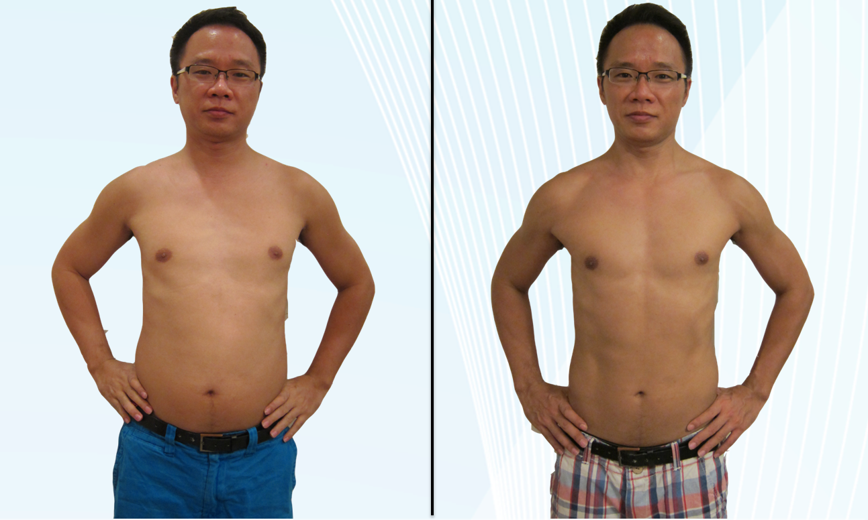
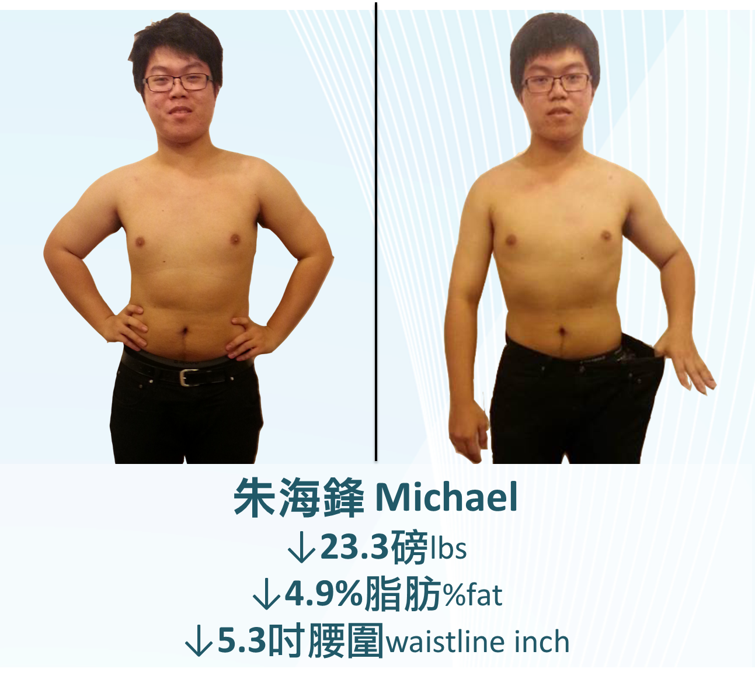
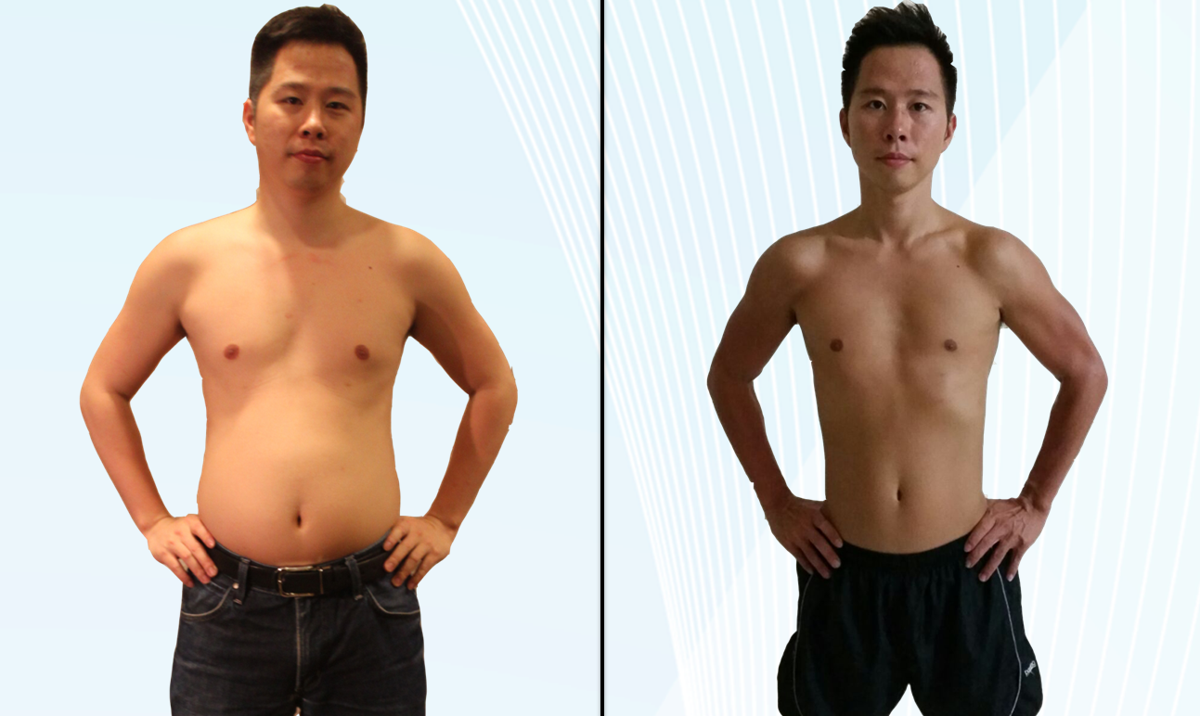
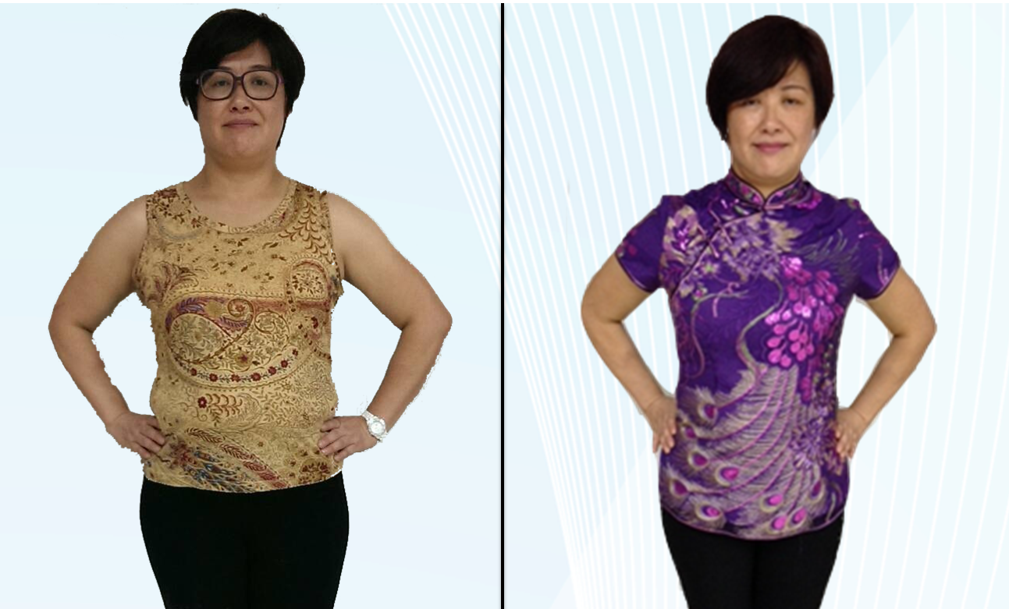
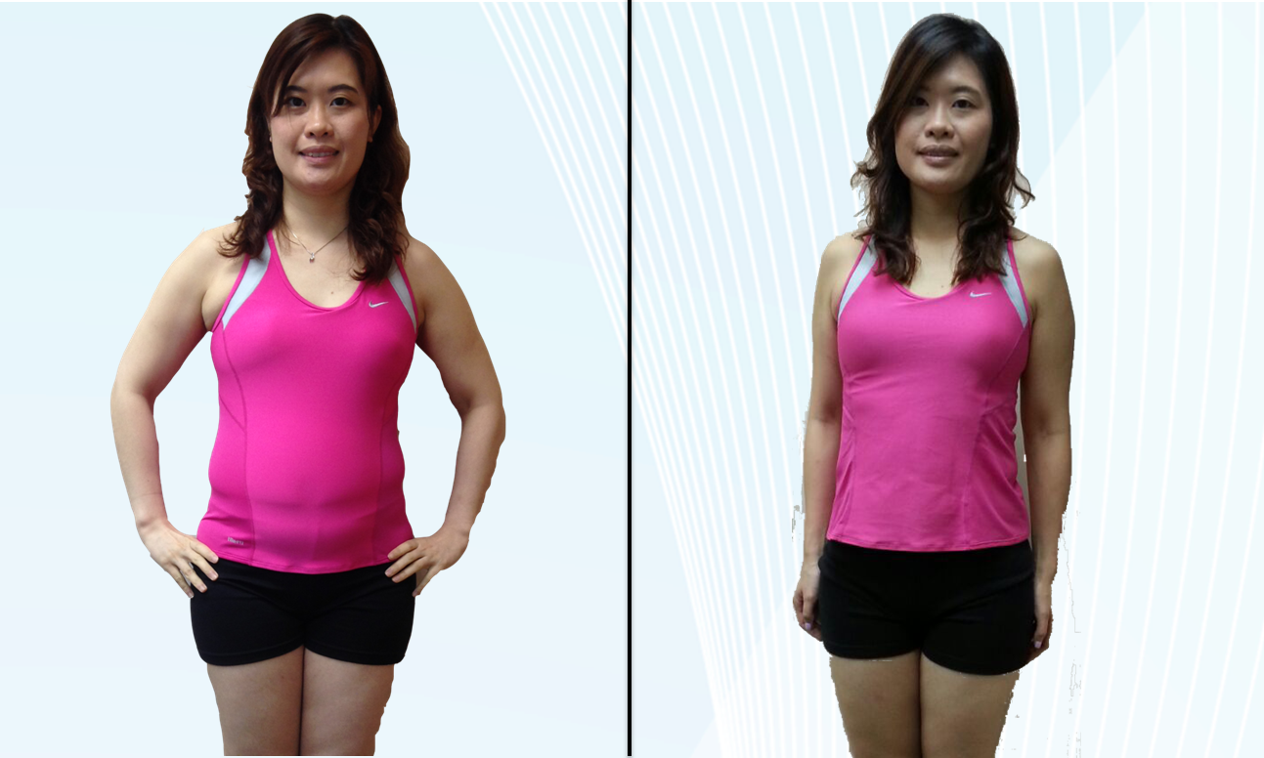
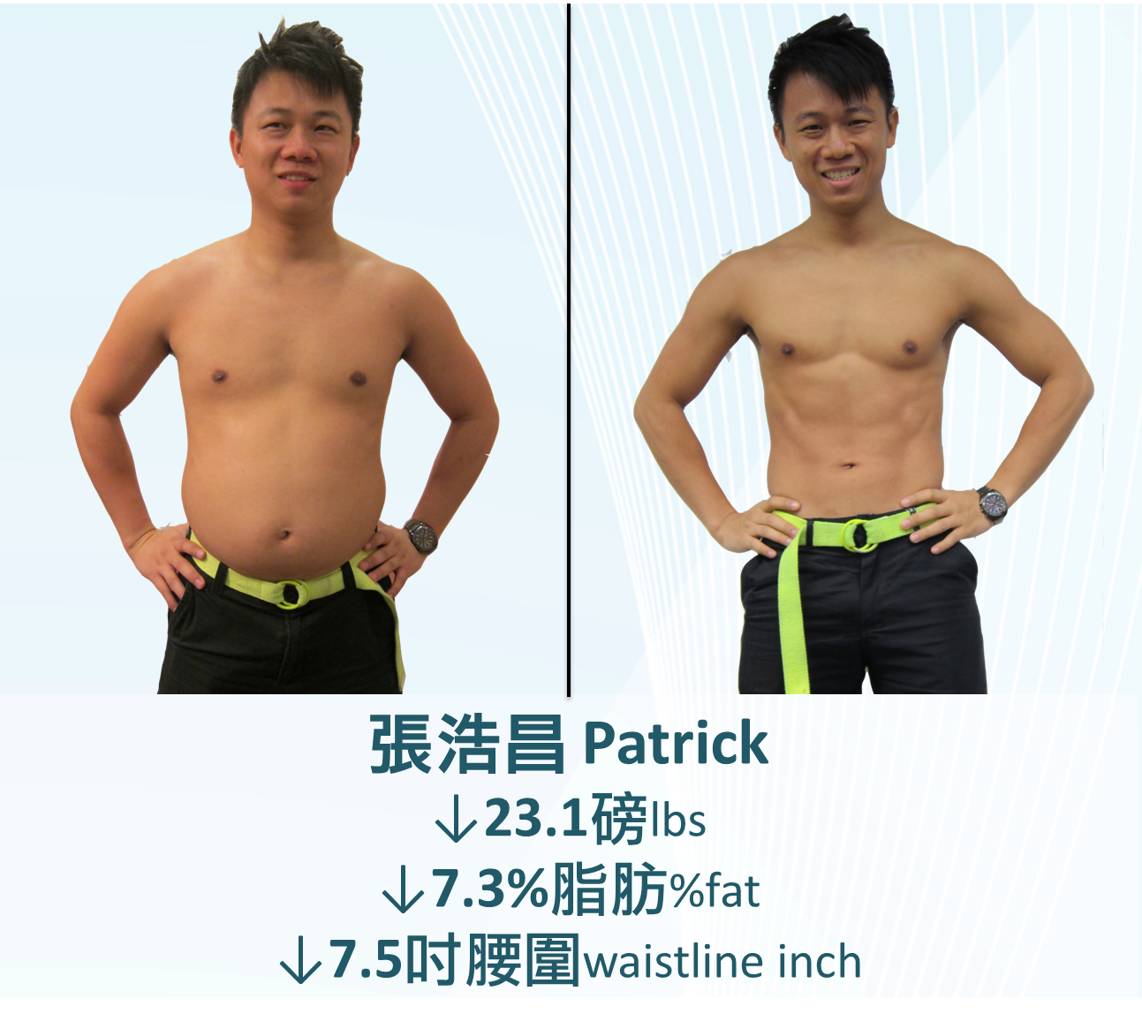
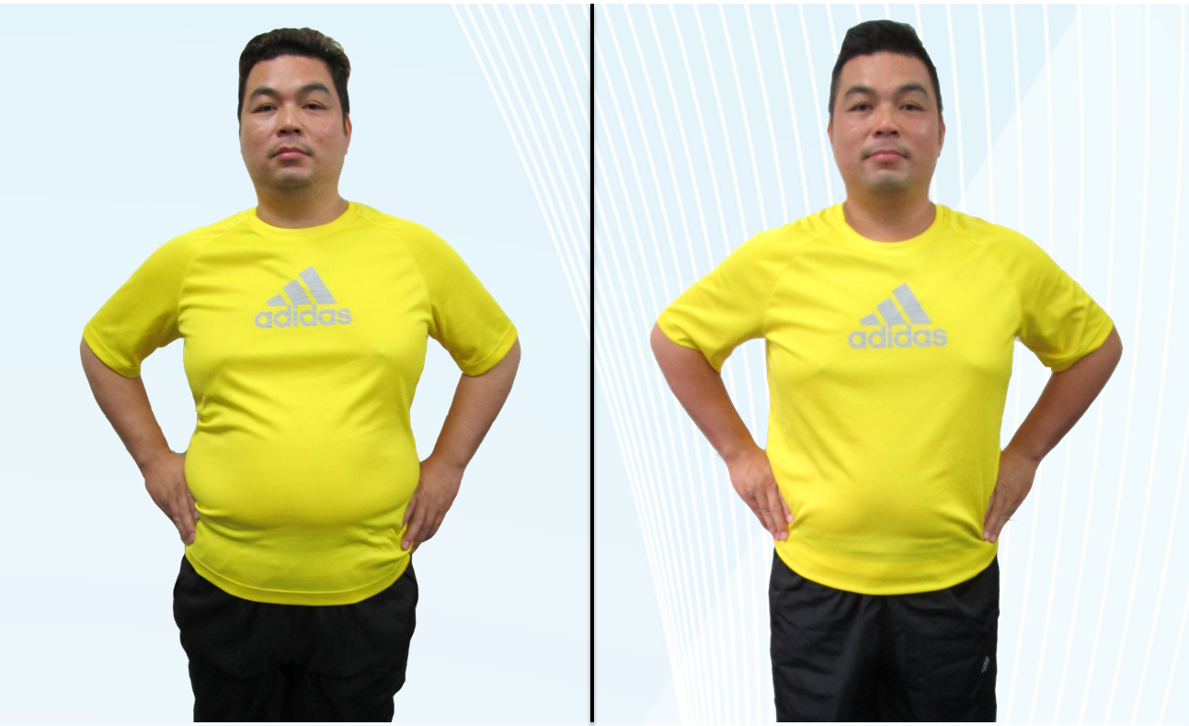
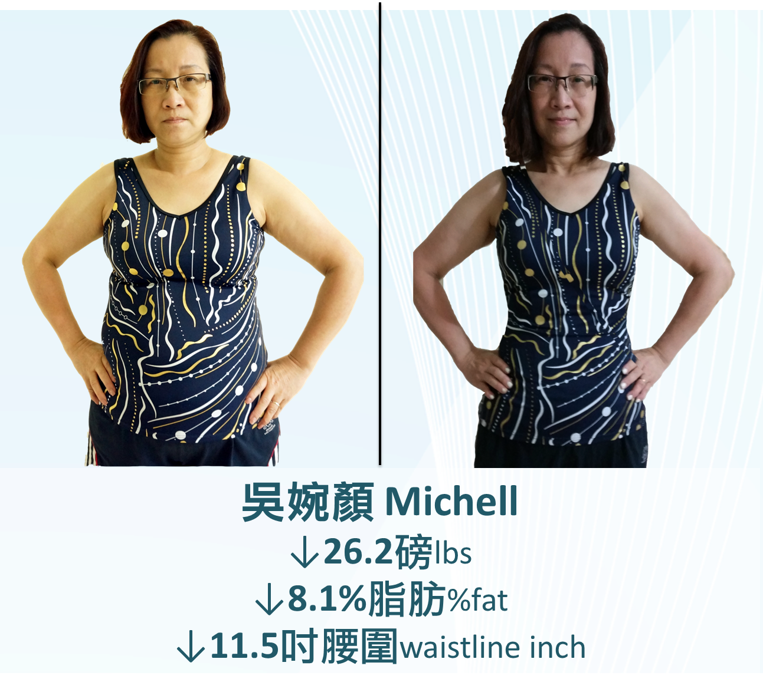
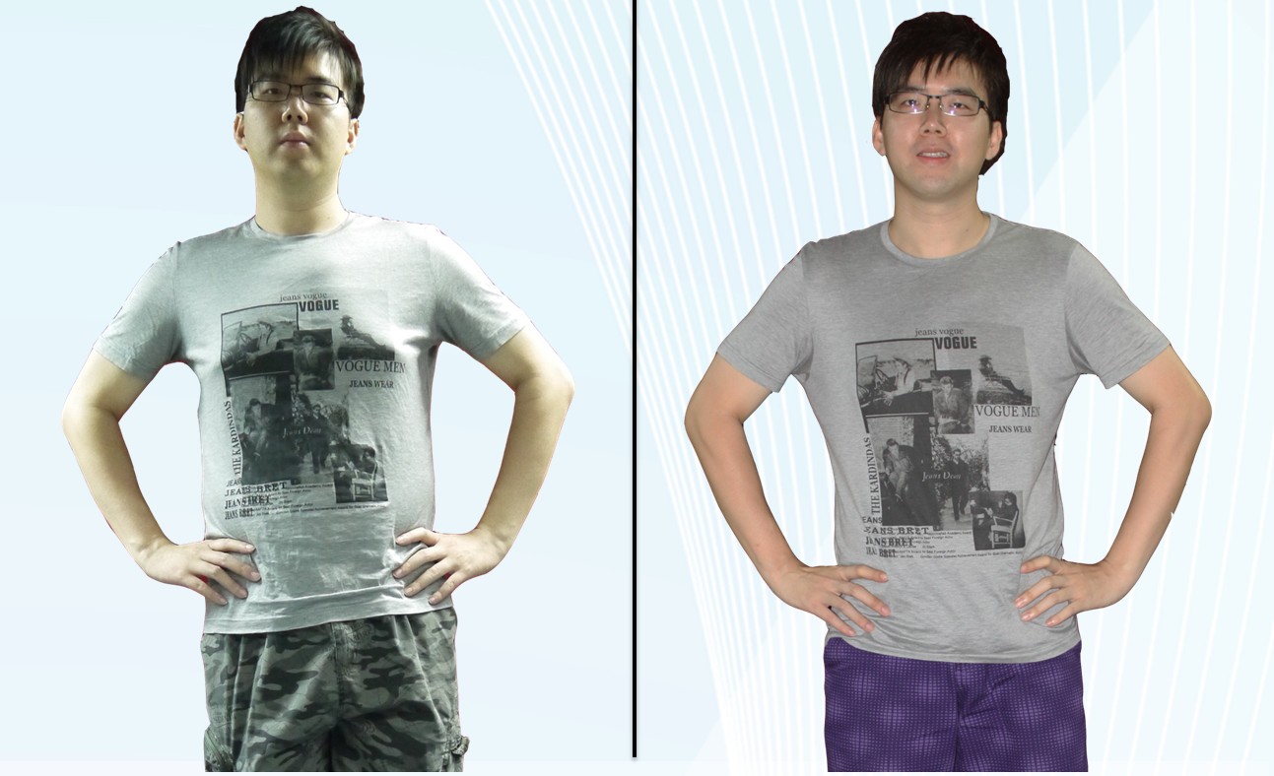
我最喜愛FYF優勝者 My Favor FYF Winner
我最喜愛FYF優勝者 My Favor FYF Winner
#4 張浩昌 CHEUNG HO CHEONG

Slide 27
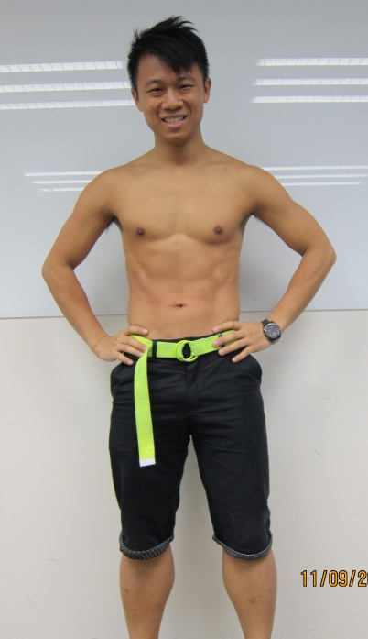
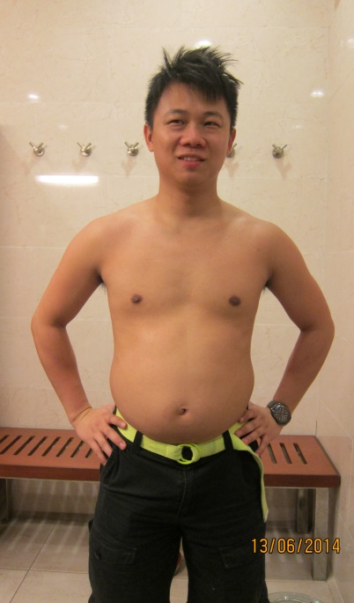
季軍
2nd RUNNER UP
4
↓23.1磅lbs
Before
↓7.3%脂肪%Fat
季軍
2nd RUNNER UP
↓7.5吋腰圍 Waistline Inch
#4 張浩昌 Cheung Ho Cheong

Slide 28
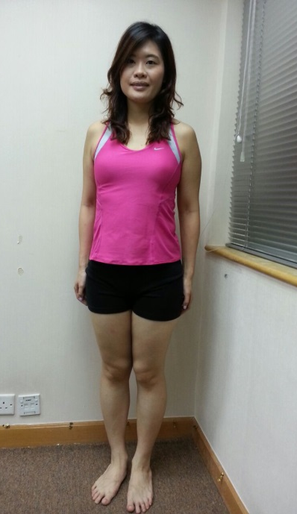
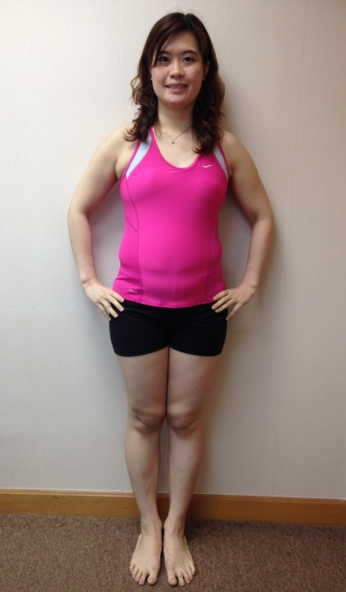
亞軍
1st RUNNER UP
4
Before
↓26.4磅lbs
亞軍
1st RUNNER UP
↓8.3%脂肪%Fat
↓8.0吋腰圍 Waistline Inch
#2 周安琪
Chau On Ki

Slide 29
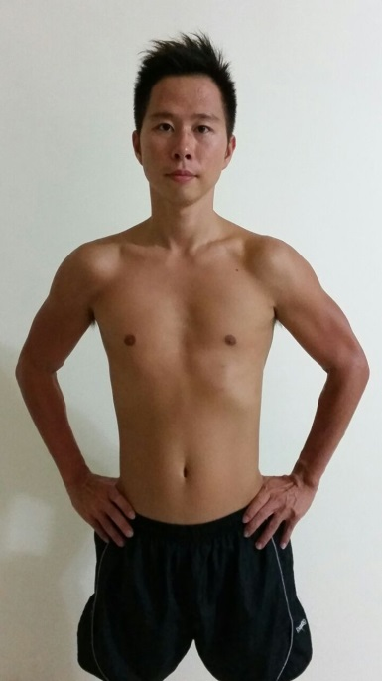
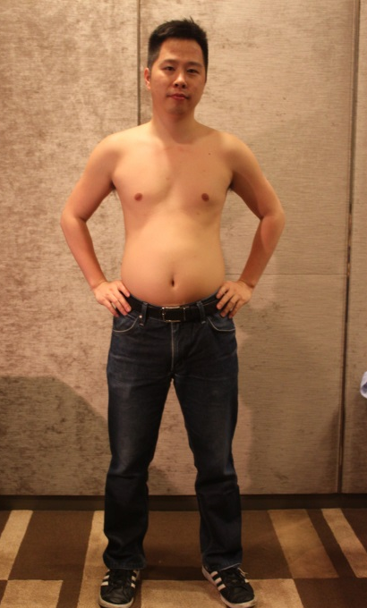
冠軍
CHAMPION
4
Before
冠軍
CHAMPION
↓35.6磅lbs
↓13.6%脂肪%Fat
↓9.5吋腰圍Waistline Inch
#1 陳國澤 CHAN Kwok Chak

